Slide 1

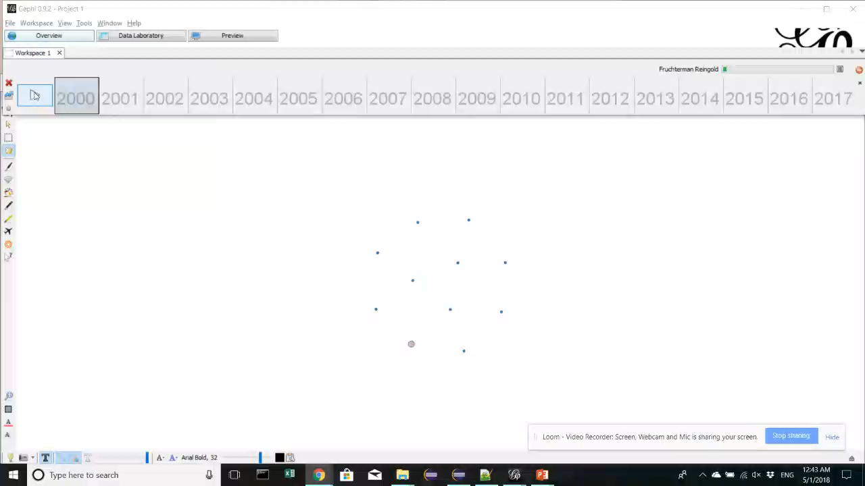
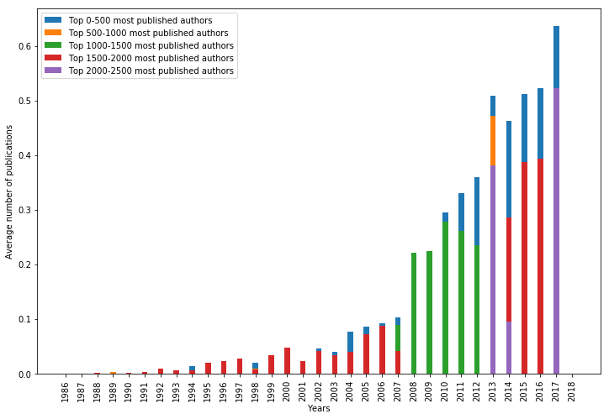
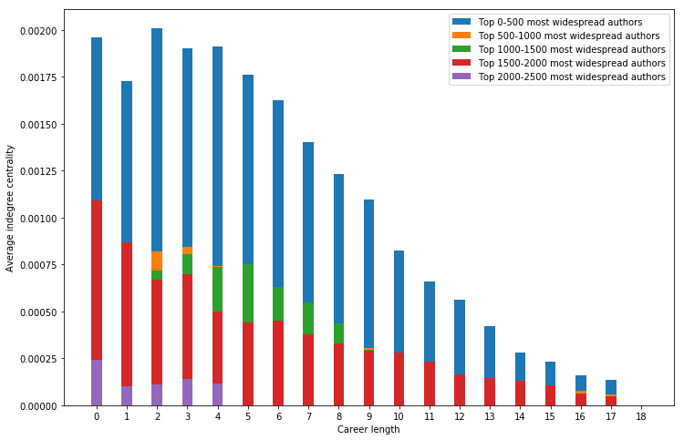
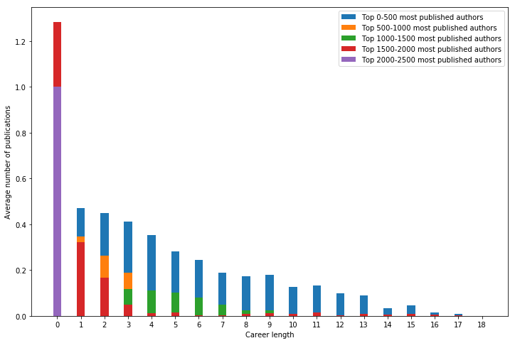
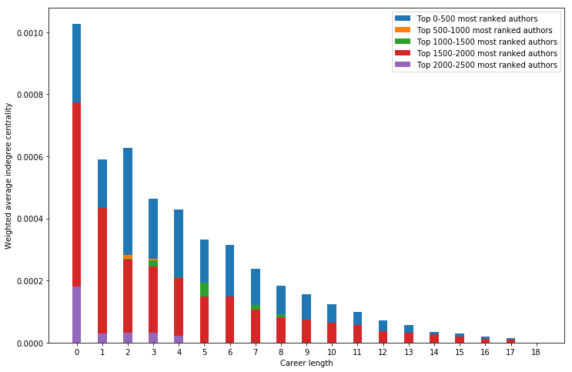
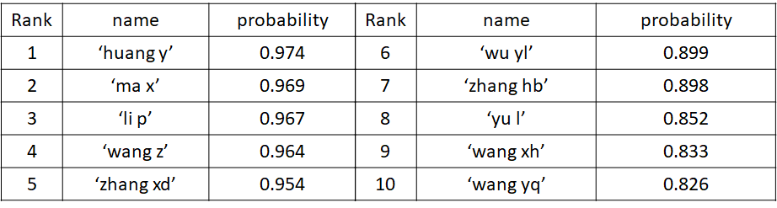
Who are the most important authors? Xiao Wang, Xiangpeng Wan, Pouria Babvey
Business Intelligence & Analytics
Introduction
Study Field:
Keyword:
We use Biomedical Material as our key word to retrieve all the related publications in this field.
Study Scope:
Motivation:
Academic prosperity bring us tons of authors and papers. Therefore industry people always interested about identifying the most valuable author and identify who is going to be the most valuable author in next few years in the emerging field. It will be valuable if we could identify those potential authors from them precisely only based on partial information. Our goal is to visualize the dynamic author citation network to see the development of Biomedical Material filed and use author’s career performance features to predict the most valuable author in the next few years.
Result
Dynamic Citation Network:
Here is a video to show our dynamic citation network from 2000 to 2017.
Each node here represent an author. The size and color of each node represent the number of authors who cited his work in a certain time period. A big and red node means this author have lots of citations during a certain time period. A small and blue node means this author have few citations during a certain time period. You can see the time period on the bottom of the screen.
From the dynamic network, we will know that the Biomedical Material getting more and more popular after 2005, more and more authors publish paper’s in this field and some of them become the leader of this area. Some top author’s will lost his academic influence as time goes by.
Most Valuable Author Prediction:
We group authors based on their number of total publications during their career life.
Number of average publication for different groups of authors:
Keyword | Biomedical Material
Year range | 1986 - 2017
#Authors | 49510
Approach
Career performance:
We use three criterias to measure the author’s career performance:
Number of publications in a certain time range (1 year)
Percentage of the authors who cited his publications in a certain time range (1 year)
Author’s PageRank value.
PageRank is an algorithm used by Google Search to rank the importance based on the number of author’s publications and the quality (measured by the citations) of the publications’ citations.
We used 1 year as the time range to measure the author’s career performance because most of the Journals and Conferences is published annually and one year is an appropriate period for author to conduct his research.
Dynamic Citation Network Approach Framework:
First we download all publications related to Biomedical Material on Web of Science. Each publication should contain:
A set of publication’s authors
The publish date
All the references in this publication
Then based on the authors of references in each publication we can conduct the citation network among authors. It is a dynamic network because the number of citations for each author is different from year to year. For example, the publications of one author’s were cited 5 times on 2010 and cited 10 times on 2011 because this author becomes more popular in 2011.
Most Valuable Author Prediction:
Based on the author’s career performance over years, we build a prediction model to predict the most valuable author in the next few years. We explore three features including the percentage of the authors who cited his publications, PageRank, number of publications in deciding the potential of the authors. All of them could be used to distinguish authors’ potential.
Prediction Approach Steps:
We use dynamic citation network with time steps to represent the state of different authors in the certain time range.
We use the t-test to prove that certain feature could be used to distinguish the potential of authors.
To compare different authors’ potential, we use the career performance as our standard.
We train our model based on 2/3 of the total data.
We use cross validation to make sure that our model works.
We use LSTM model to predict the potential authors given only partial information.
Finally we give a prediction of the top 10 valuable author by using our model based on the most recently citation network.
Web of Science
Download all publications related to Biomedical Material
Publications
Conduct the citation network
Dynamic Citation Network
Class one are significant high, number of publications could be used for distinguish potential authors
Class one are significant high, page rank could be used for distinguish potential authors
Conclusion & Feature work
Conclusion: List of the authors who have most potential to become a famous author:
Feature work:
We could use if the author cooperate with the leading author in this field as a feature to predict the potential of him.
We can also use the funding of the author as a feature to increase our model’s precision.
http://www.stevens.edu/school-business/masters-programs/business-intelligence-analytics

